Slide 1
HUMAN ACTIVITY RECOGNITION USING GENERARATIVE ADVERSARIAL NETWORK
TEAM 6
GUIDE: Dr.T.Jackulin,M.E.,(Ph.D)
Assistant Professor,
Department of CSE
Done by BALUMURI AMRUTHA(211417104013) SANA RUSHITHA REDDY(211417104235) USIRIKE SWETHA REDDY(211417104285)

Slide 2
AGENDA
INTRODUCTION
LITERATURE SURVEY
PROBLEM STATEMENT
OBJECTIVE
TECHNOLOGY STACK
SYSTEM ARCHITECTURE
ARCHITECTURE OF GAN
USE CASE DIAGRAM
ACTIVITY DIAGRAM
SEQUENCE DIAGRAM
COLLABORATION DIAGRAM
MODULES
TESTING
SCREENSHOTS
CONCLUSION
PUBLICATIONS

Slide 3
INTRODUCTION
This world is counting on challenges of computer vision for its automation. We face many problems during the detection of human pose.
For a better computer vision for human pose recognition we use Generative Adversarial Network algorithm.
The input source for our model is through video surveillances or through any cameras. The captured videos will undergoes following 3 processes:
Detection of person on the video feed.
Key point generation on the detected human.
Processing with GAN algorithm module. Using the above process the recognition of the human pose can be done even with the blurred image.

Slide 4
LITERATURE SURVEY
S.No | Title | Year | Author Name | Description | Dataset | Size
1 | A benchmark for human pose estimation and tracking, arXiv preprint arXiv:1710.10000, 2017. | OCT 2017 | M. Andriluka, U. Iqbal, A. Milan, E. Insafutdinov, L. Pishchulin, J. Gall, and B. Schiele, Posetrack | The videos are from MPII Human Pose dataset. This dataset focusses on 3 aspects: (1) single-frame multi-person pose estimation. (2) multi-person pose estimation in videos. (3) multi-person articulated tracking. | PoseTrack | 514 videos including 66 374 frames 300 videos training 50 videos validation 208 videos testing

Slide 5
LITERATURE SURVEY
2 | Ai challenger: A large-scale dataset for going deeper in image understanding, arXiv preprint arXiv:1711.06475, 2017. | NOV 2017 | J. Wu, H. Zheng, B. Zhao, Y. Li, B. Yan, R. Liang, W. Wang, S. Zhou, G. Lin, Y. Fu, et al., | Data are crawled from Internet. It is the largest human pose image dataset currently | AI Challenger | 210103 images training 30103 images validation 60103 images testing
3 | , Microsoft coco: Common objects in context, in European Conference on Computer Vision, Zurich, Switzerland, 2014, pp. 740–755. | 2014 | T.-Y. Lin, M. Maire, S. Belongie, J. Hays, P. Perona, D. Ramanan, P. Dollar, and C. L. Zitnick | Data are from Internet. It contains diverse activities. | MSCOCO | 115103 images training 5103 images validation 20103 images test-Dev 20103 images test-Challenge

Slide 6
LITERATURE SURVEY
4 | , 2d human pose estimation: New benchmark and state of the art analysis, in Proceedings of the IEEE Conference on Computer Vision and Pattern Recognition, Columbus, WI, USA, 2014, pp. 3686–3693. | 2014 | M. Andriluka, L. Pishchulin, P. Gehler, and B. Schiele | Data are from YouTube videos. It covers 410 human activities and each image is provided with activity label. | MPII Human pose | 410 activities 2.5104 images
5 | Modec: Multimodal decomposable models for human pose estimation, in Computer Vision and Pattern Recognition (CVPR), Portland, OR, USA, 2013, pp. 3674–3681. | 2013 | B. Sapp and B. Taskar, | Data are from Hollywood movies. The persons are occluded or severely nonfrontal are deleted. | FLIC | 3987 images training 1016 images testing

Slide 7
LITERATURE SURVEY
6 | Clustered pose and nonlinear appearance models for human pose estimation, in Proceedings of the British Machine Vision Conference, Aberystwyth, UK, 2010. | 2010 | S. Johnson and M. Everingham | Data are from Flicker with sport category tag. Images are scaled. Only one person is annotated in each image. | LSP | 1000 images training 1000 images testing
7 | Progressive search space reduction for human pose estimation, in Computer Vision and Pattern Recognition, Anchorage, AK, USA, 2008, pp. 1–8. | 2008 | V. Ferrari, M. Marin-Jimenez, and A. Zisserman | Data are from TV show. Line segments are provided to indicate position. Size and orientation of body parts are also provided. Only one person is annotated in each image | Buffy | 472 frames training 276 frames testing

Slide 8
PROBLEM STATEMENT
Generative adversarial networks (GANs) are a class of artificial intelligence algorithms used in unsupervised machine learning, implemented by a system of two neural networks contesting with each other in a zero-sum game framework.
Activity detection is a major problem in smart videos surveillance.
These applicants need real-time detection performance, but it is generally vey time consuming to detect the actual activity
. Human Activity Recognition or HAR for short, is the problem of predicting what a person is doing based on a trace of their movement using sensors

Slide 9
OBJECTIVE
To improve the accuracy of detecting the human pose by using Generative Adversarial Network.
To develop an improved method for detecting the human pose on live
To ensure the effectiveness of the proposed approach during detection of human pose.
To reduce computational time
Future enhancement in detecting the persons in cctv, images or videos

Slide 10
TECHNOLOGY STACK
Language: Python (python libraries)
Software Interface: Anaconda Navigator. Open CV
HARDWARE SYSTEM CONFIGURATION:
Processor - Intel Core i7 or i5 or i3
RAM - 4 GB
Hard Disk - 500 GB

Slide 11
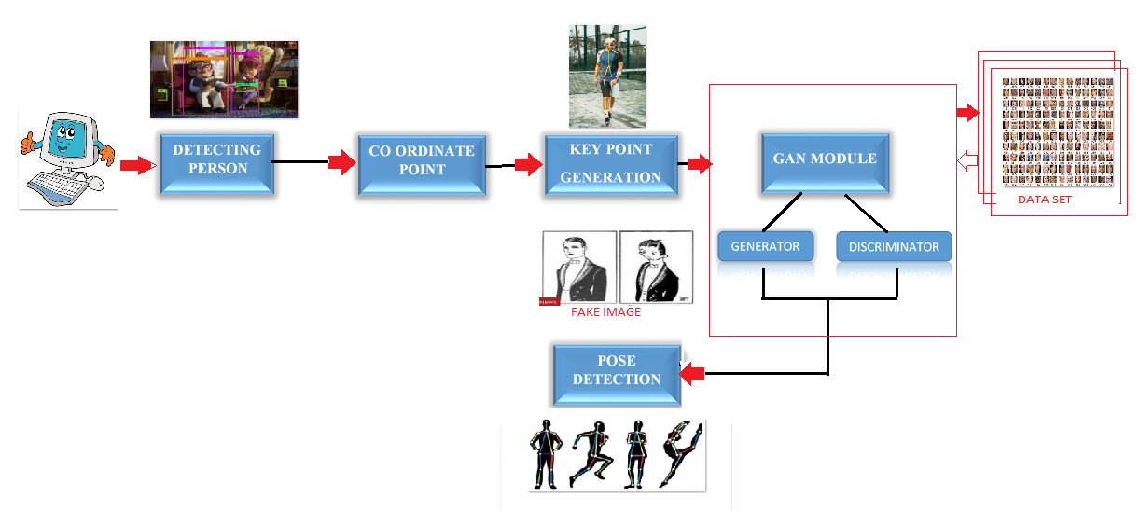
SYSTEM ARCHITECTURE

Slide 12
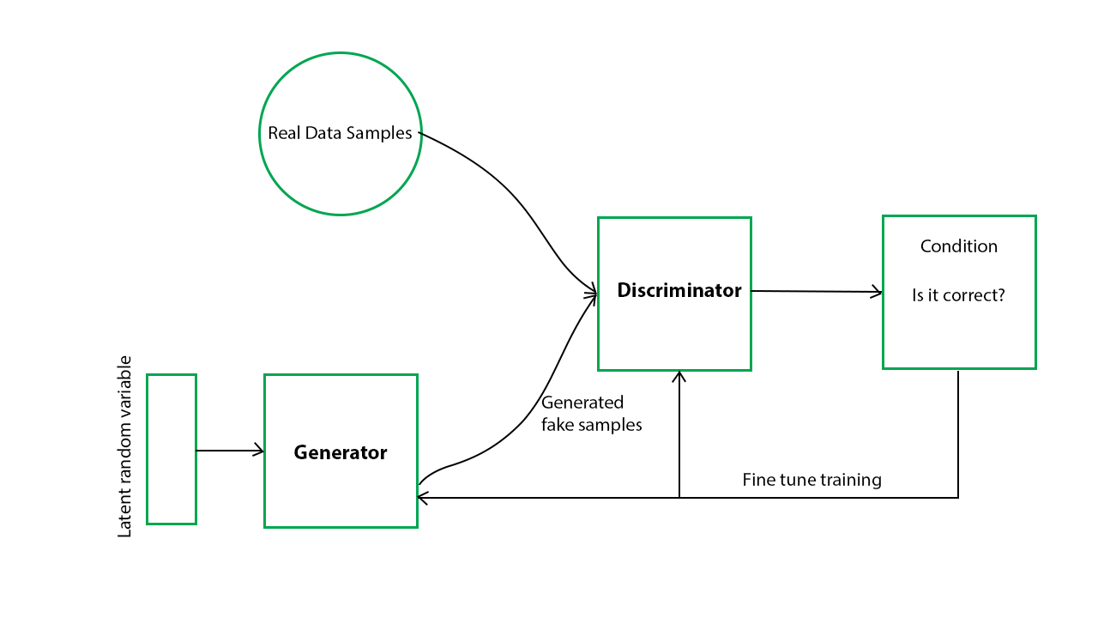
ARCHITECTURE OF GAN

Slide 13
USECASE DIAGRAM
IMAGE

Slide 14
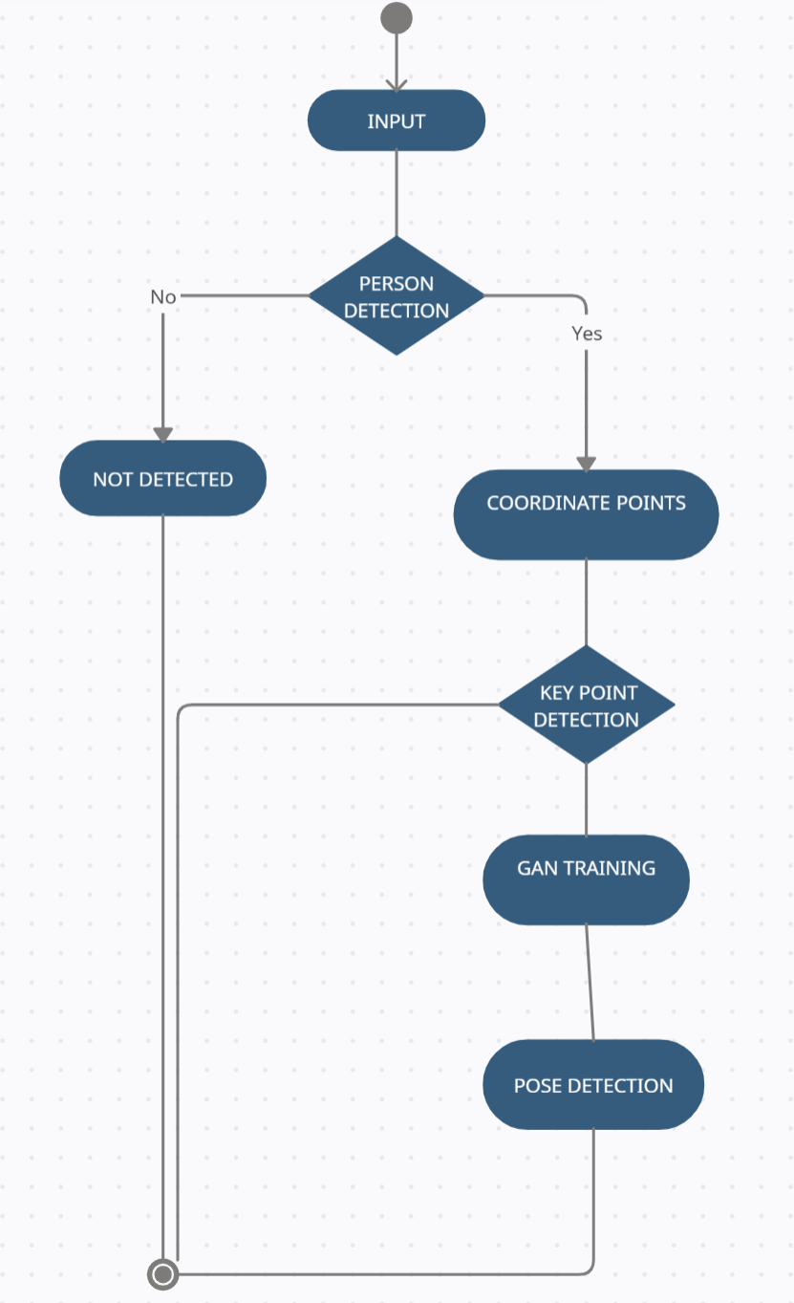
ACTIVITY DIAGRAM

Slide 15
SEQUENCE DIAGRAM

Slide 16
COLLABORATION DIAGRAM

Slide 17
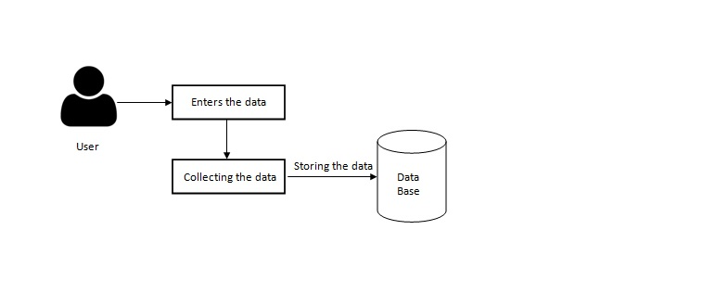
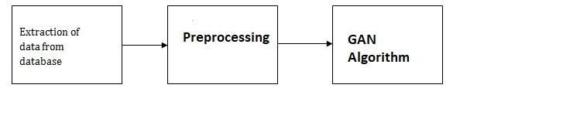
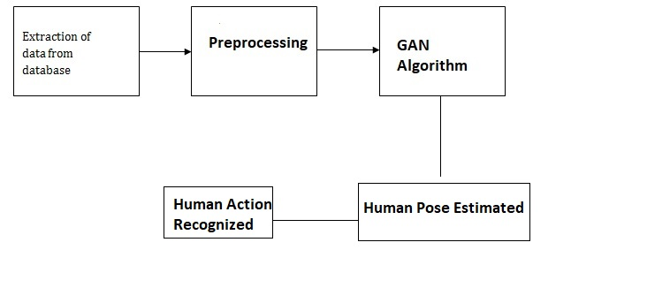
DFD

Slide 18
MODULE
MODULES:
Detecting the person
Coordinate separation or key point generation
Pose detection
DETECTING THE PERSON:
To detect a person on the frame, using cluster grouping algorithm on a set of detection areas which define a set of features based on spatial, color and temporal information for each detection.
Then using these features, we cluster the detections. We finally define a measure to calculate the actual number of people within each cluster to infer the final estimation of the number of people in the scene. Can also classify the gender using colors.

Slide 19
MODULE
COORDINATE POINT or KEY POINT:
To determine the pose of the human and to classify the pose structure, we need to determine the coordinate points such as elbow, shoulder, neck, knee, hip, toe, etc., which might help us to determine exact pose of the human. To coordinate the points we use Generative Adversarial Network Algorithm.
GENERATIVE ADVERSARIAL NETWORK (GAN) ALGORITHM:
GAN has two parts generator and discriminator the generator generates fake samples of data(be it an image, audio, etc.) and tries to fool the Discriminator.
The Discriminator, on the other hand, tries to distinguish between the real and fake samples. The Generator and the Discriminator are both Neural Networks and they both run in competition with each other in the training phase.
The steps are repeated several times and in this, the Generator and Discriminator get better and better in their respective jobs after each repetition.
POSE DETECTION:
After determining all the possible position of the human image using generator and discriminator, now it would make us very simple to determine exact position of the human and to understand the human gesture.

Slide 20
TESTING
Testing is a process of executing a program with the intent of finding an error. A good test case is one that has a high probability of finding an as-yet –undiscovered error. A successful test is one that uncovers an as-yet- undiscovered error.
System testing is the stage of implementation, which is aimed at ensuring that the system works accurately and efficiently as expected before live operation commences.
It verifies that the whole set of programs hang together. System testing requires a test consists of several key activities and steps for run program, string, system and is important in adopting a successful new system.
Any engineering product can be tested in one of the two ways:
White-Box testing Black-Box testing

Slide 21
UNIT TESTING
Unit testing involves the design of test cases that validate that the internal program logic is functioning properly, and that program inputs produce valid outputs. All decision branches and internal code flow should be validated.
It is the testing of individual software units of the application .it is done after the completion of an individual unit before integration. This is a structural testing, that relies on knowledge of its construction and is invasive.
Unit tests perform basic tests at component level and test a specific business process, application, and/or system configuration. Unit tests ensure that each unique path of a business process performs accurately to the documented specifications and contains clearly defined inputs and expected results.

Slide 22
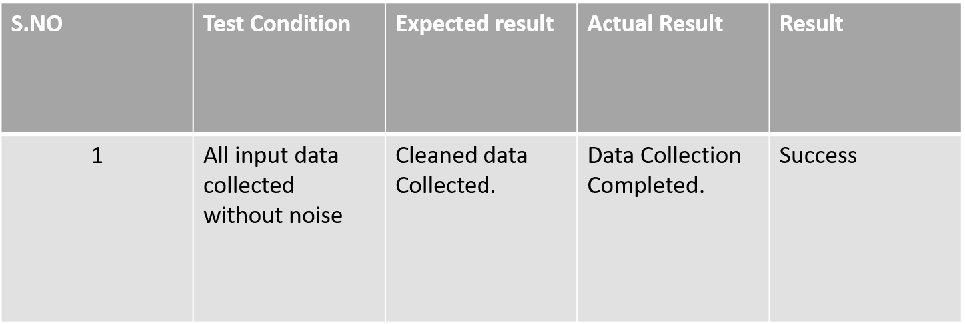

Slide 23
VALIDATION TESTING
Validation testing is done to validate the inputs given by the user. The user inputs are checked for their correctness and range. If there are errors, the error message is given and the user is prompted again to enter the new value.

Slide 24
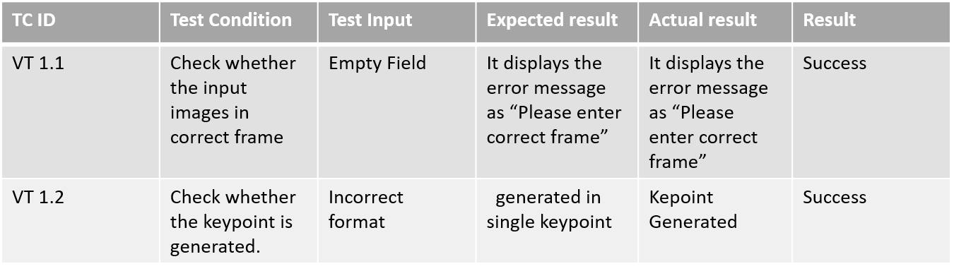

Slide 25
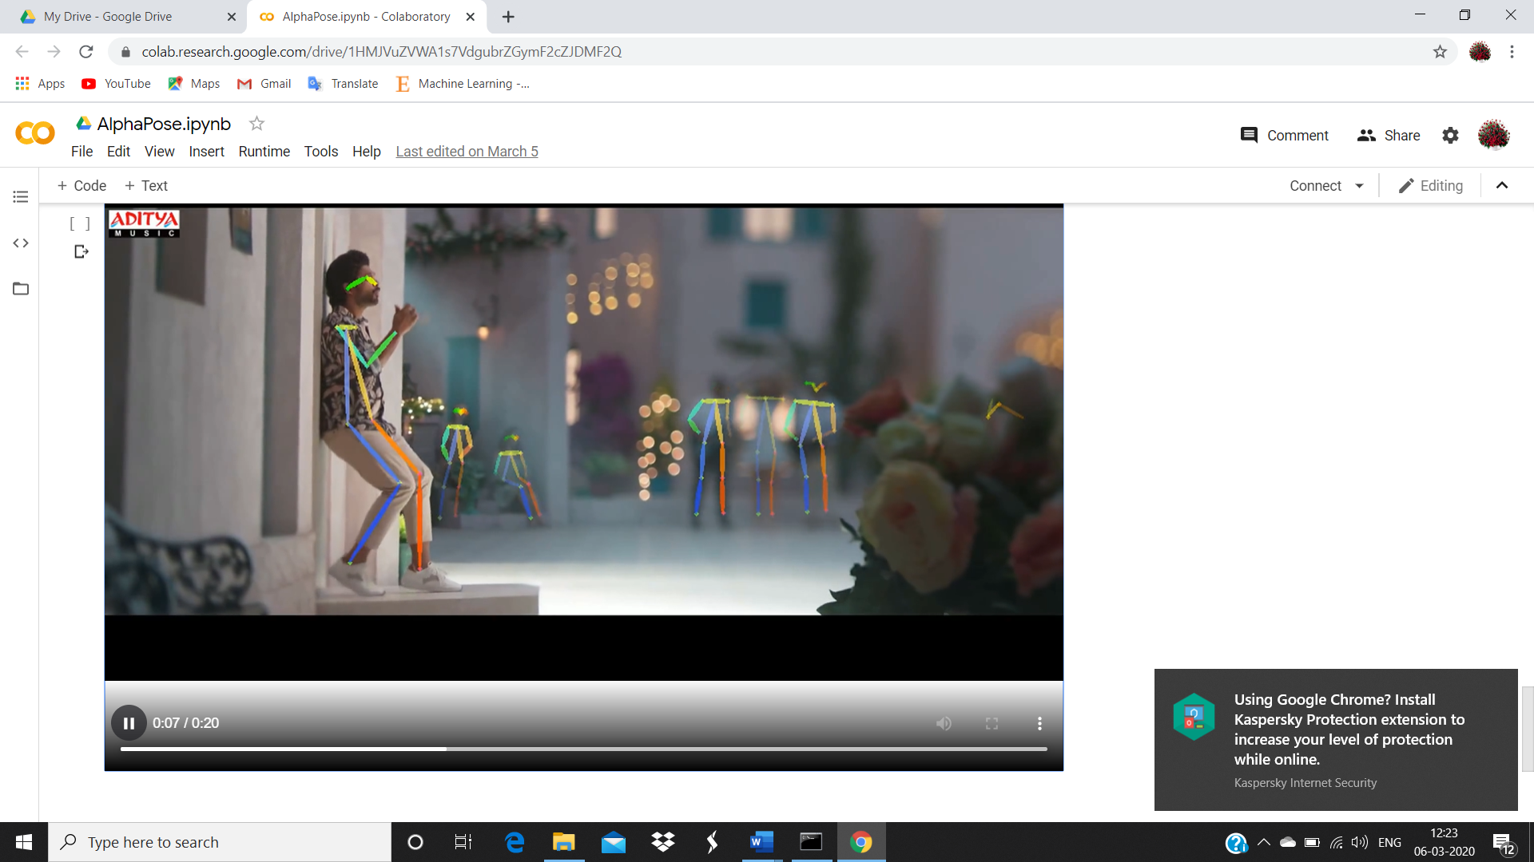
KEY POINT GENERATED

Slide 26
INTEGRATION TESTING
Software integration testing is the incremental integration testing of two or more integrated software components on a single platform to produce failures caused by interface defects.
The task of the integration test is to check that components or software applications, e.g. components in a software system or – one step up – software applications at the company level – interact without error.

Slide 27
DEBUGGING
Debugging is a methodical process of finding and reducing the number of bugs or defects in a computer program or a piece of electronic hardware, thus making it behave as expected. Debugging tends to be harder when various subsystems are tightly, as changes in one may causes bugs to emerge in another.

Slide 28
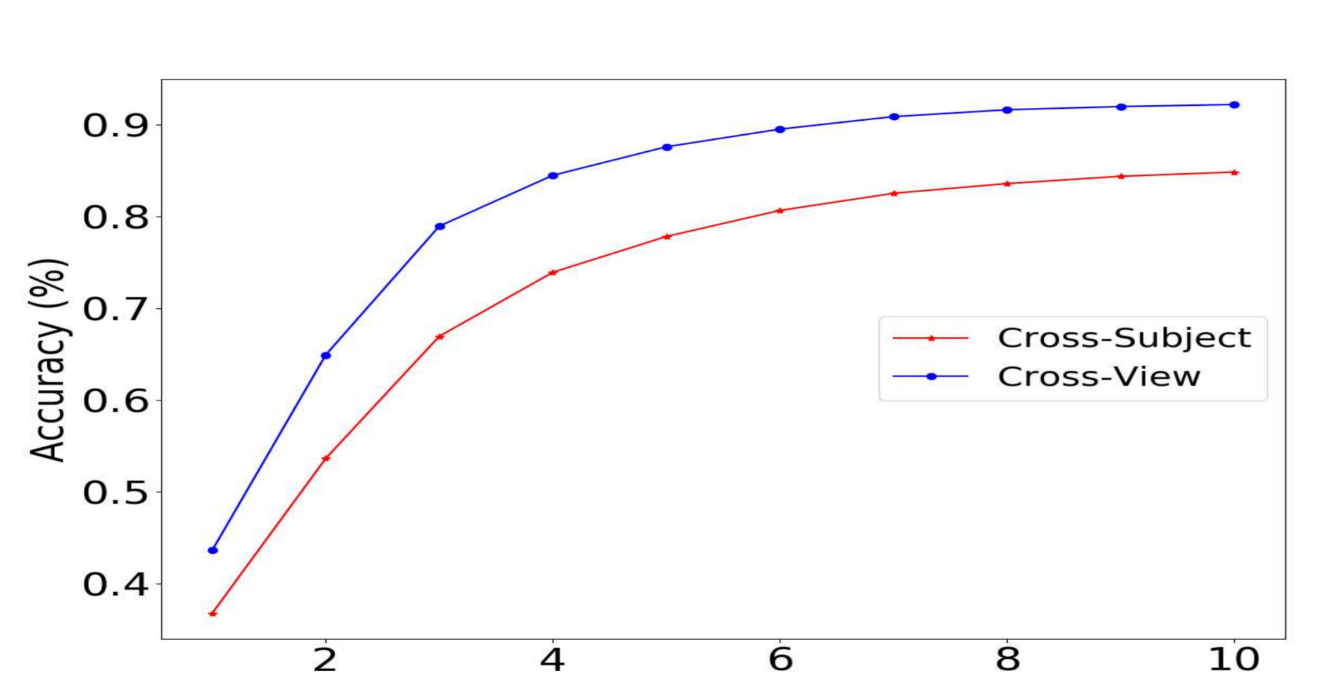
PERFORMANCE ANALYSIS

Slide 29
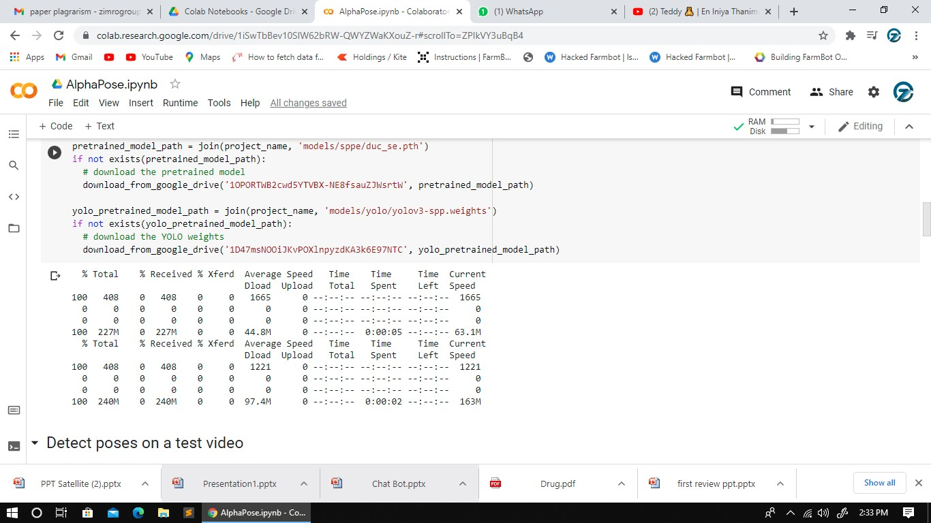
SCREENSHOTS OF WORK DONE

Slide 30

SCREENSHOTS OF WORK DONE

Slide 31

SCREENSHOTS OF WORK DONE

Slide 32
CONCLUSION
From the above observations in this paper we address that proposed system endures the difficulties in capturing the images with GAN based machine learning model and optimizes the blurred images.
This proposed system provides novelty about performance measures related to the quality of human pose detections.
This model concise about small variations that capable of increase the amount of real data applications involving live human datasets.

Slide 33
PUBLICATION
This project was presented as a paper at the Fourth International Conference on Intelligent Computing held at Panimalar Engineering College on 26.03.2021, by Amrutha Balumuri, Sana Rushitha Reddy, Usirike Swetha Reddy and N. Indira .

Slide 34
REFERENCES
https://towardsdatascience.com/generative-deep-learning-lets-seek-how-ai-extending-not-replacing-creative-process-fded15b0561b
https://missinglink.ai/guides/convolutional-neural-networks/generative-adversarial-networks/
https://www.researchgate.net/profile/Yu_Qiao8/publication/308496682/figure/tbl2/AS:668252325810201@1536335178894/Accuracy-rate-of-CNN-s.png.
https://medium.com/activating-robotic-minds/understanding-generative-adversarial-networks-4dafc963f2ef
https://searchenterpriseai.techtarget.com/definition/generative-adversarial-network-GAN
https://www.geeksforgeeks.org/generative-adversarial-network-gan/
https://blog.paperspace.com/implementing-gans-in-tensorflow/

Slide 35
REFERENCES
S. Zhang, R. Benenson, M. Omran, J. Hosang, and B. Schiele, “How far are we from solving pedestrian detection?” in Proc. IEEE Conf. Comput. Vis. Pattern Recognit., 2016, pp. 1259–1267.
P. Dollar, Z. Tu, P. Perona, and S. Belongie, “Integral channel features,” ´ in Proc. Brit. Mach. Vis. Conf., 2009, pp. 91.1–91.11
W. Nam, P. Dollar, and J. H. Han, “Local decorrelation for improved ´pedestrian detection,” in Proc. Adv. Neural Inf. Process. Syst., 2014, pp. 424– 432.
S. Zhang, R. Benenson, and B. Schiele, “Filtered channel features for pedestrian detection.” in Proc. IEEE Conf. Comput. Vis. Pattern Recognit., 2015, pp. 1751– 1760. Y. Yang, Z. Wang, and F. Wu, “Exploring prior knowledge for pedestrian detection.” in Proc. Brit. Mach. Vis. Conf., 2015, pp. 176.1–176.12.
J. Cao, Y. Pang, and X. Li, “Pedestrian detection inspired by appearance constancy and shape symmetry,” in Proc. IEEE Conf. Comput. Vis. Pattern Recognit., 2016, pp. 1316–1324.
S. Zhang, C. Bauckhage, and A. B. Cremers, “Informed haar-like features improve pedestrian detection,” in Proc. IEEE Conf. Comput. Vis. Pattern Recognit., 2014, pp. 947–954.
P. F. Felzenszwalb, R. B. Girshick, D. McAllester, and D. Ramanan, “Object detection with discriminatively trained part-based models,” IEEE Trans. Pattern Anal. Mach. Intell., vol. 32, no. 9, pp. 1627–1645,2010.

Slide 36
THANK YOU

